Slide 1

Table of Contents
1) What Is A Dashboard In Business?
2) Dashboard Types For Each Business Need
3) Strategic Dashboard Examples
4) Operational Dashboard Examples
5) Analytical Dashboard Examples
6) Tactical Dashboard Examples
7) Dashboards Do's & Don'ts

Slide 2
Business Intelligence
Business intelligence has evolved into smart solutions that provide effective data management - from extracting, monitoring, analyzing, and deriving actionable insights needed to stay competitive on the market, to powerful visualizations created with a dashboard builder which enables business users to interact with data and drill into bits and pieces of information they might need, at any time, any place.

Slide 4
What Is A Dashboard In Business?
A car dashboard instantaneously identifies and provides feedback regarding the status of the automobile: speed, servicing needs, tire pressure, fuel level, etc.
Dashboards in business do the same thing, only much more. Through dashboards, organizations can quickly identify current and historical performance.
Organizations can also further utilize the data to define metrics and set goals. By integrating these key performance indicators (KPIs) and goals into their dashboards, companies can proactively identify issues, minimize costs, and strive to exceed performance expectations. Of course, it is also important to choose the right KPI.

Slide 5
What Is A Dashboard In Business?
In the recent years, dashboards have been used and implemented by many different industries, from healthcare, HR, marketing, sales, logistics, or IT, all of which have experienced the importance of dashboard implementation as a way to reduce cost and increase the productiveness of their respected business.
It doesn’t matter from which business you’re coming from or how big your company is, you always want effective results and clear actions to be taken after an issue is discovered.
Let’s explain that with a dashboard example:

Slide 6
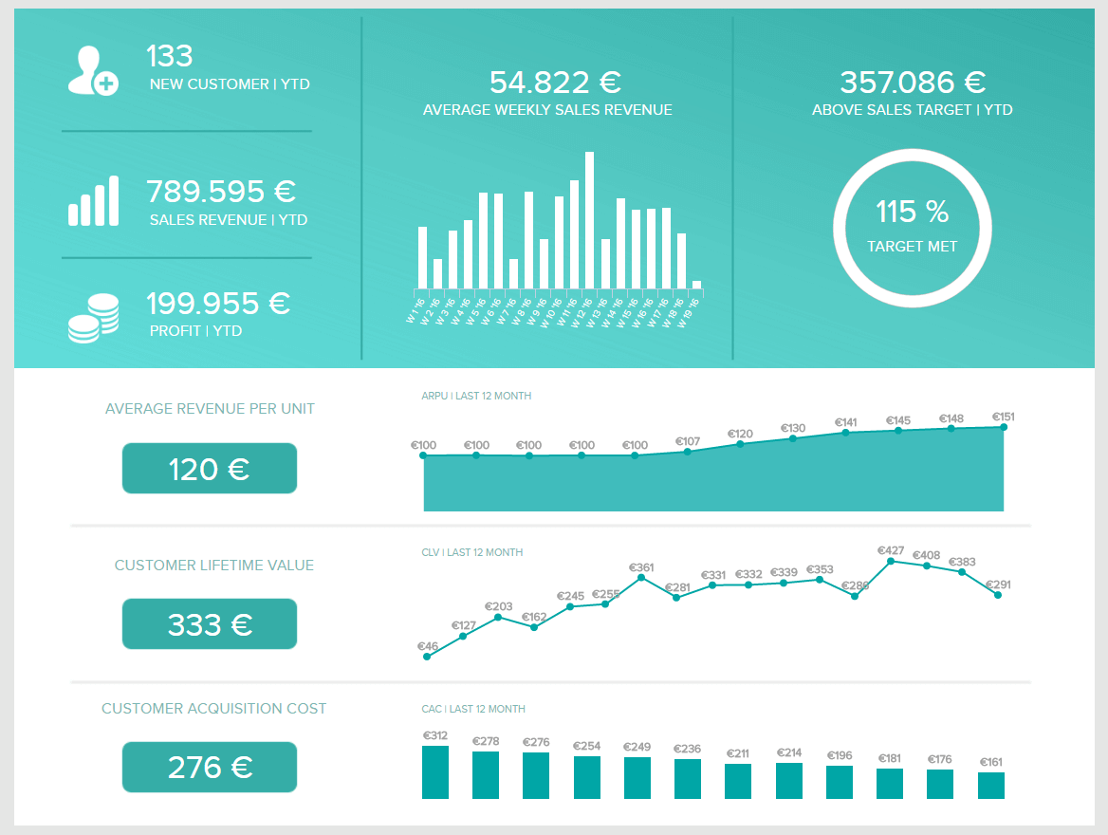
The sales performance dashboard above is a one-stop shop for sales insights.
The dashboard provides the perfect overview of the progress of the sales department by focusing on various sales KPIs:
1.Sales growth
2.Sales targets
3.Average revenue per unit (ARPU)
4. Customer acquisition cost (CAC)
5. Customer lifetime value (CLV).
At a glance, sales managers can see whether or not their team is meeting their individual goals. Managers can also see if the team as a whole is reaching its goals.

Slide 7
Deficiency of Such Dashboard
The traditional types of reporting don’t meet the requirements of today’s data management nor can they produce efficiency like an interactive dashboard where sets of data are presented in a complementary way.
An effective dashboard combines information dynamically to measure performance and drive business strategy.
That interactivity is indeed what drives a profitable result by visually depict important data that can be accessed by different departments. Cloud-based, real-time online data visualization software enables fast, data-driven action by decision-makers.

Slide 8
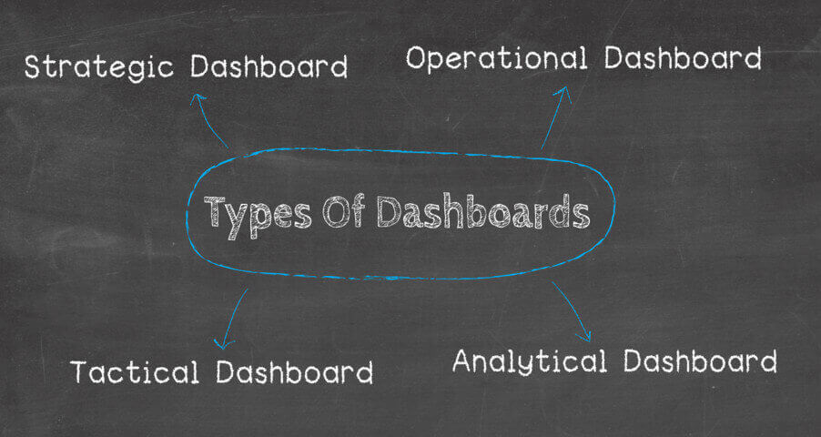
Dashboard Types For Each Business Need
What Problems Are You Trying To Solve?
To help you on your way to determine what kind of problems you need to solve, you should start with these inquiries:
What is the main purpose of a dashboard?
What type of dashboard are you building? etc.

Slide 9
Dashboard Types For Each Business Need
There are 4 general subtypes of dashboards:
1. Strategic - focused on long-term strategies and high-level metrics
2. Operational - shows shorter time frames and operational processes.
3. Analytical - contains vast amounts of data created by analysts.
Tactical - used by mid-management to track performance.
Each of these dashboard types comes with different requirements for the level of summary, analytic capabilities, and user interfaces.

Slide 10
Dashboard Complexity
TYPE OF DASHBOARD | LEVEL OF SENIORITY | TIME APPLICATION | LEVEL OF COMPLEXITY
STRATEGIC | Senior Management | Long-term | Complex
TACTICAL & ANALYTICAL | Middle Management | Medium-term | Less Complex
OPERATIONAL | Junior Management | Routine | Simple

Slide 11
What Is A Strategic Dashboard?
A strategic dashboard is a reporting tool for monitoring the long-term company strategy with the help of critical success factors. They’re usually complex in their creation, provide an enterprise-wide impact to a business, and are mainly used by senior-level management.
They track performance metrics against enterprise-wide strategic goals. As a result, these dashboards tend to summarize performance over set time frames: past month, quarter, or year. When the strategic dashboard is properly developed, designed, and implemented, it can effectively reduce the amount of time needed to accomplish a specific business key performance indicator, while reducing operational costs.

Slide 12
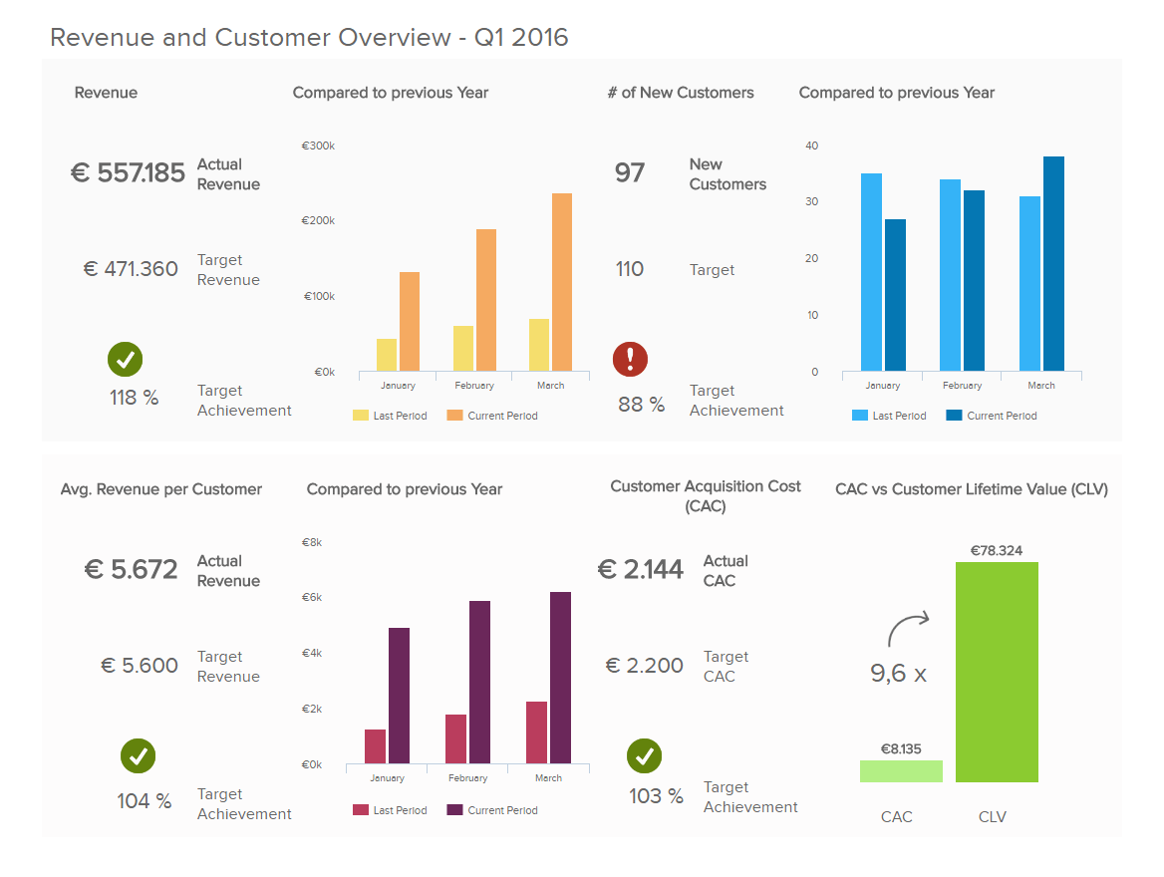
Examples of Strategic Dashboard?
Management Strategic Dashboard
This dashboard below is one of the best strategic dashboard examples that could easily be displayed in a board meeting.
It isn’t cluttered, but it quickly tells a cohesive data story.
It includes significant KPIs: customer acquisition costs, customer lifetime value, and sales target.

Slide 13
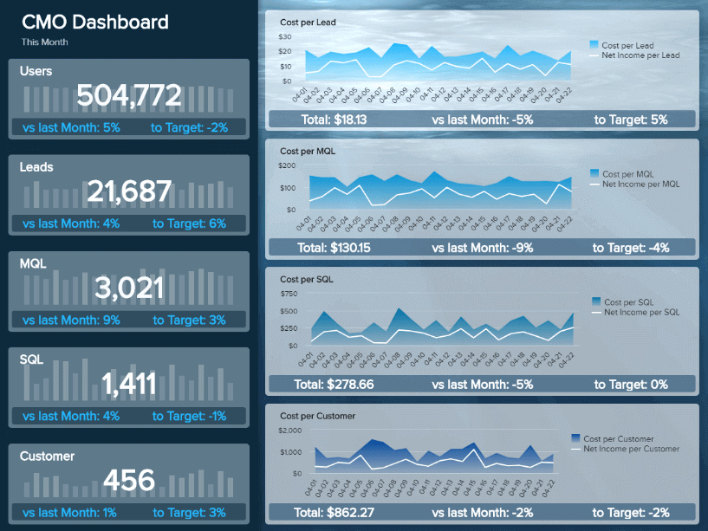
Examples of Strategic Dashboard?
b) CMO strategic dashboard
The dashboard expounds on the cost of acquiring each customer, leads, MQL, and compares them to previous periods, and set targets.
To build this dashboard, you don’t need to have extensive IT skills or advanced database management knowledge.
The important part is that you understand your strategic goals, and the KPIs you need to achieve them.

Slide 14
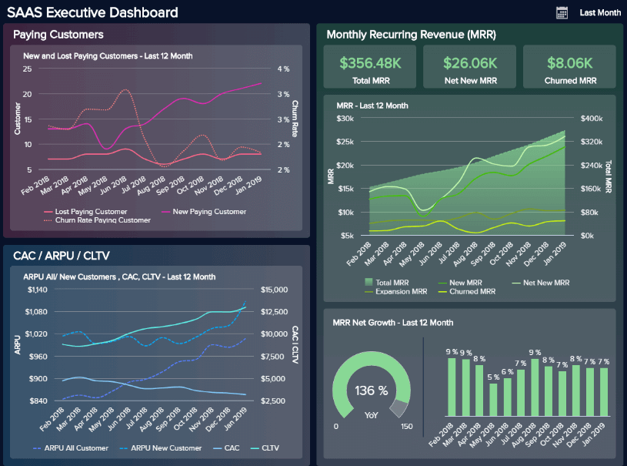
Examples of Strategic Dashboard?
c) SaaS management dashboard
Here, managers get an overview of the three most important areas for any Software as a Service company:
1.Customers
2. Revenue
3. Costs
Also, the Monthly Recurring Revenue is one of the most important metrics to track for a SaaS business as it can give a notion of how much is the business growing.

Slide 15
What Is An Operational Dashboard?
An operational dashboard is one of the types of dashboards used for monitoring and managing operations that have a shorter time horizon. Since they focus on tracking operational processes, they’re usually administrated by junior levels of management.
These kinds of dashboards are arguably the most common ones.
They are mostly used for monitoring and analyzing a company’s activities in a given business area. These dashboards are usually focused on alerting about business exceptions and are based on real-time data.
Operational metrics dashboards usually end up in the hands of the subject matter experts.

Slide 16
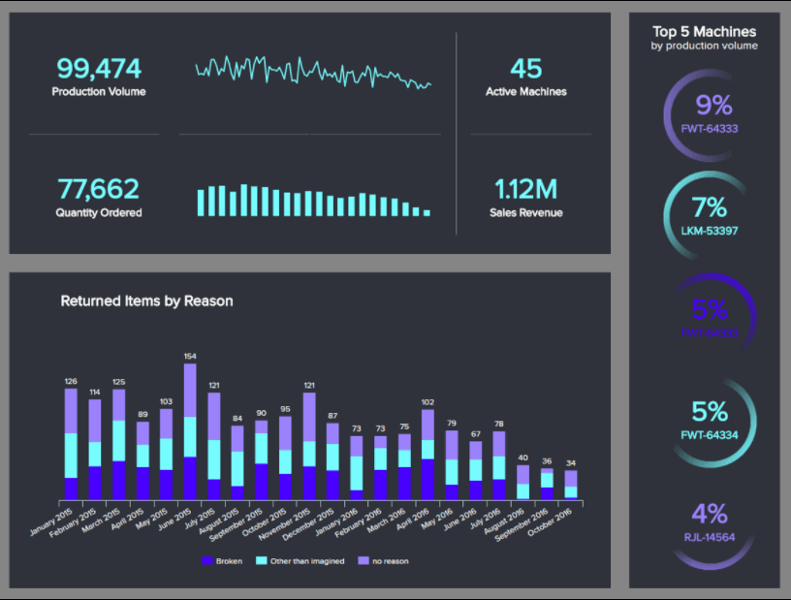
Examples of Operational Dashboard?
Manufacturing Production
This dashboard gives a detailed overview of all aspects related to production, from the volume, quantity ordered, returned items, to machines’ performance.
Getting this level of insights can help manufacturers to spot any potential issues or hidden trends that could harm production as well as find improvement opportunities to optimize key processes.

Slide 17
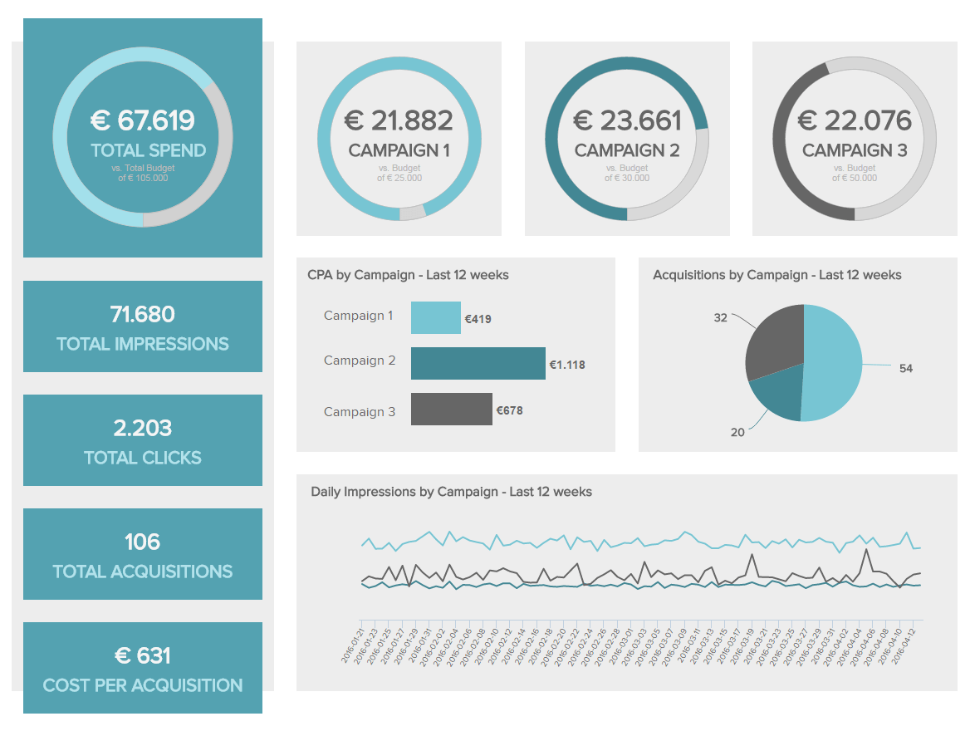
Examples of Operational Dashboard?
b) Marketing Operational Dashboard
It shows the performance of 3 campaigns over the past 12 weeks.
It provides important operational metrics and KPI for the marketing team on cost per acquisition, total number of clicks, total acquisitions gained, & the total amount spent in the specific campaign.
Any significant changes would immediately alert the marketing team.

Slide 18
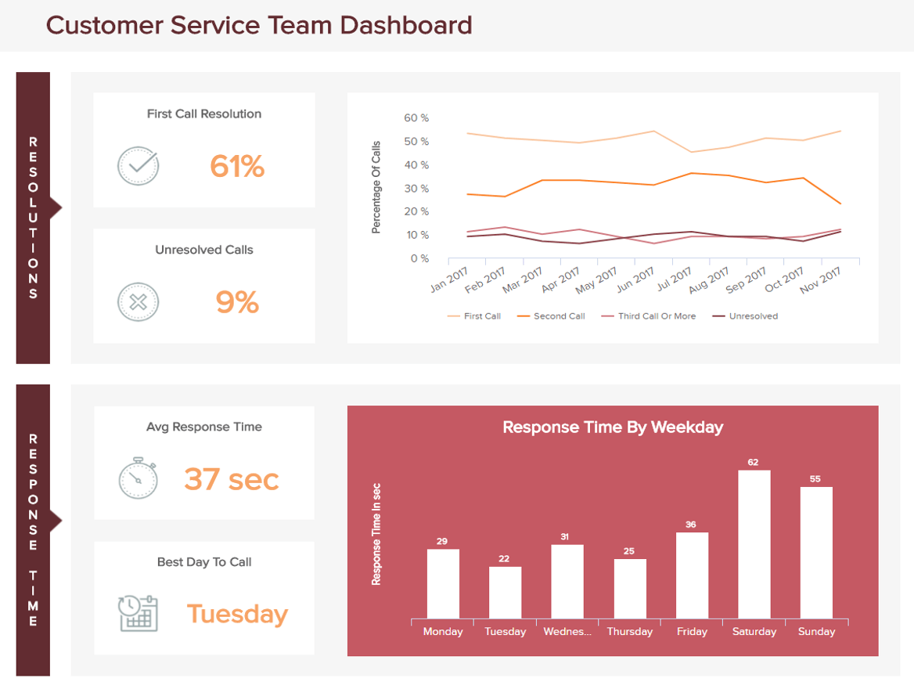
Examples of Operational Dashboard?
c) Customer Service Operational Metrics
This dashboard expounds on the customer service team’s performance over a shorter timeframe, in this case, daily, with an additional monthly overview of the first, second, third call, and unresolved ones.
We can see that the customer service dashboard is divided into 2 parts:
The resolutions
The response time.

Slide 19
What Is An Analytical Dashboard?
An analytical dashboard is a type of dashboard that contains a vast amount of data created and used by analysts to provide support to executives.
They supply a business with a comprehensive overview of data, with middle management being a crucial part of its usage.
Like mentioned earlier, the importance of an analytical dashboard lies within its impact on historical data usage, where analysts can identify trends, compare them with multiple variables and create predictions, and targets, which can be implemented in the business intelligence strategy of a company.
They are often useful when complex categorized information is massive and broad, and need visualization to perform a clear analysis of generated data.

Slide 20
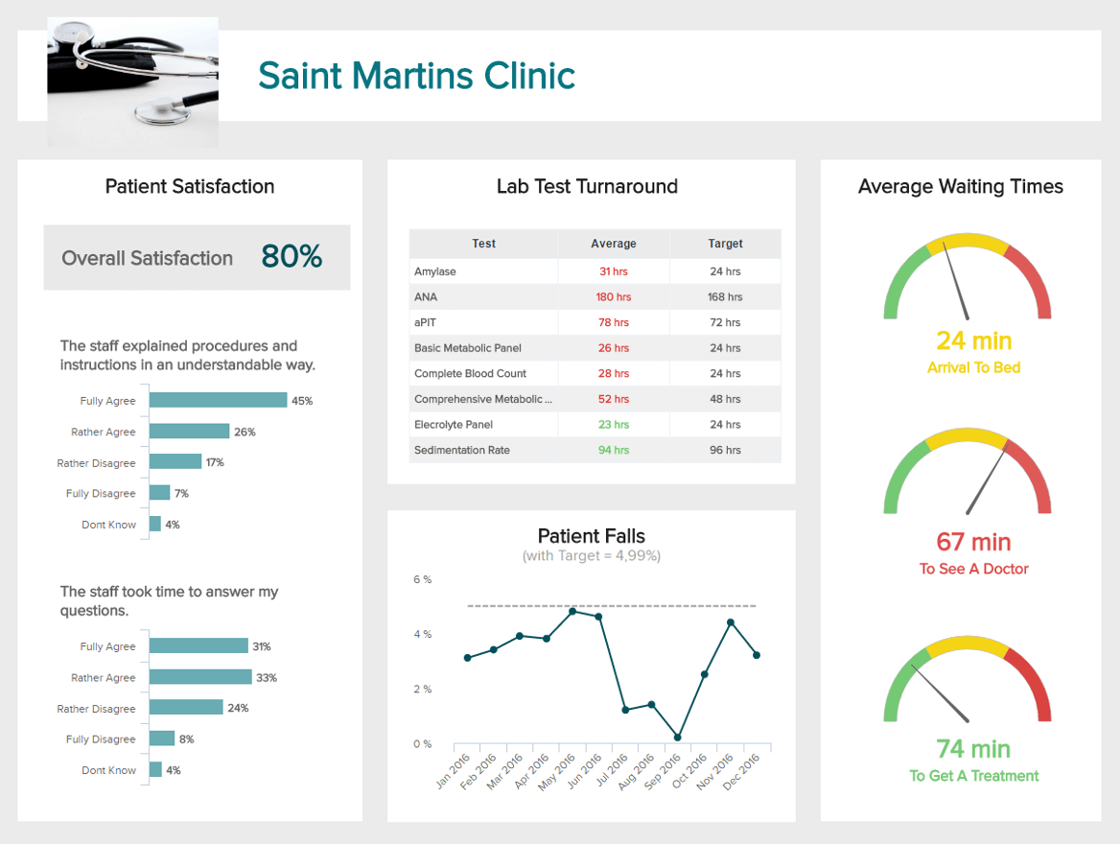
Examples of Analytical Dashboard?
Healthcare Analytical Dashboard
This dashboard aims to monitor all aspects related to how satisfied are your patients with your facility and the service it provides.
Covering aspects such as staff, treatment, waiting times, and safety.
This dashboard will help you to assess your relationship with patients and ensure they are getting everything they need.

Slide 21
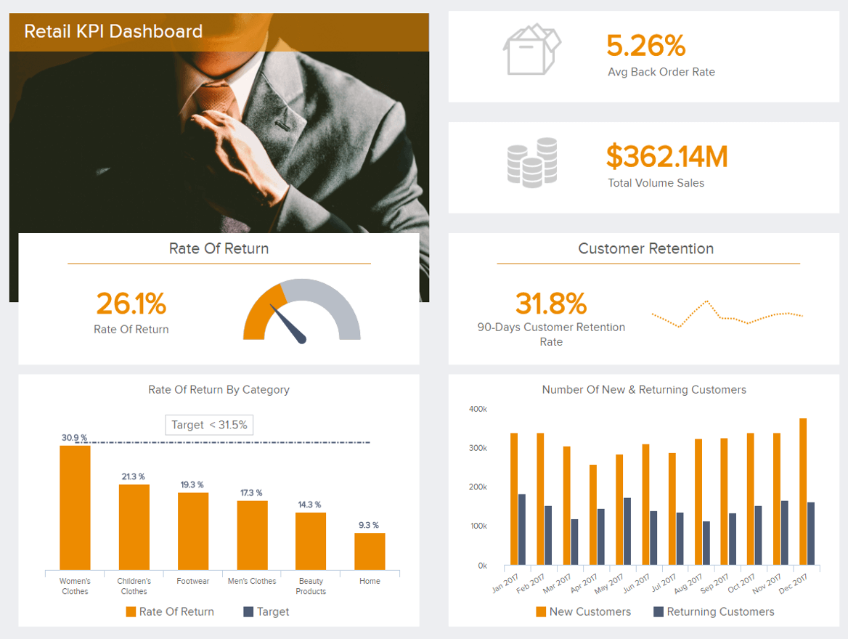
Examples of Analytical Dashboard?
b) Analytical retail KPI dashboard
The dashboard shows some of the crucial metrics such as
Rate of return (also depicted by category)
The total volume of sales customer retention rate
The number of new returning customers through a set timeframe

Slide 22
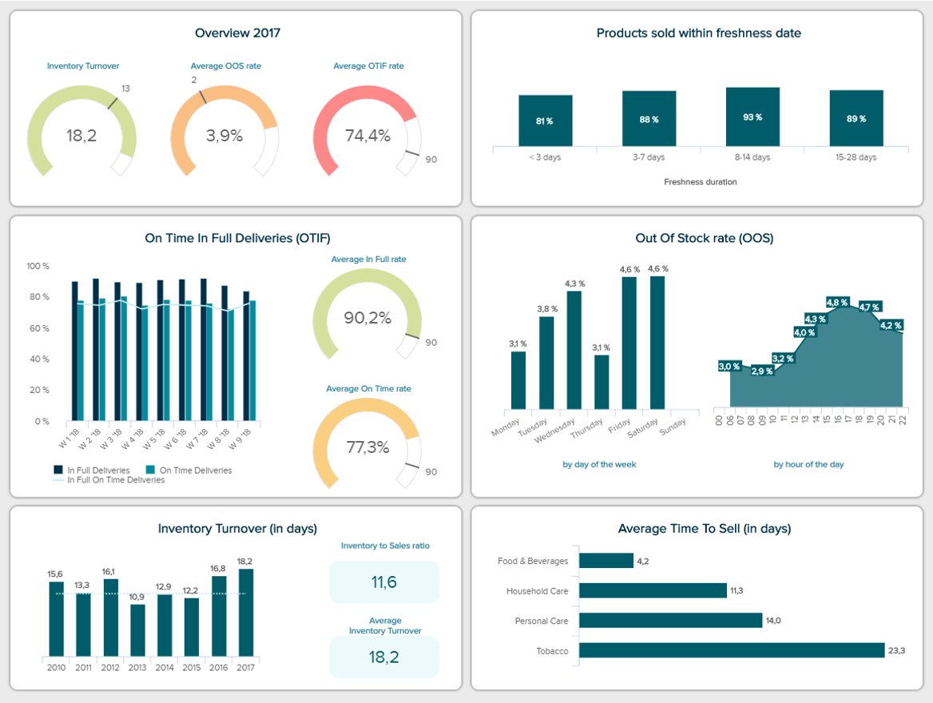
Examples of Analytical Dashboard?.
c) KPI Dashboard for FMCG industry
KPIs related to deliveries, products sold, inventory, and stock, the FMCG dashboard gives an overview of all important aspects for the correct functioning of a fast-moving consumer goods business.
By tracking the out-of-stock rate closely you get a picture of the status of your inventory and avoid stockouts that can affect sales.

Slide 23
What Is A Tactical Dashboard?
A tactical dashboard is utilized in the analysis and monitoring of processes conducted by mid-level management, emphasizing the analysis.
Then an organization effectively tracks the performance of a company’s goal and delivers analytic recommendations for future strategies.
Tactical dashboards are often the most analytical dashboards. They are great for monitoring the processes that support the organization’s strategic initiatives.
Tactical dashboards help guide users through the decision process. They capitalize on the interactive nature of dashboards by providing users the ability to explore the data.

Slide 24
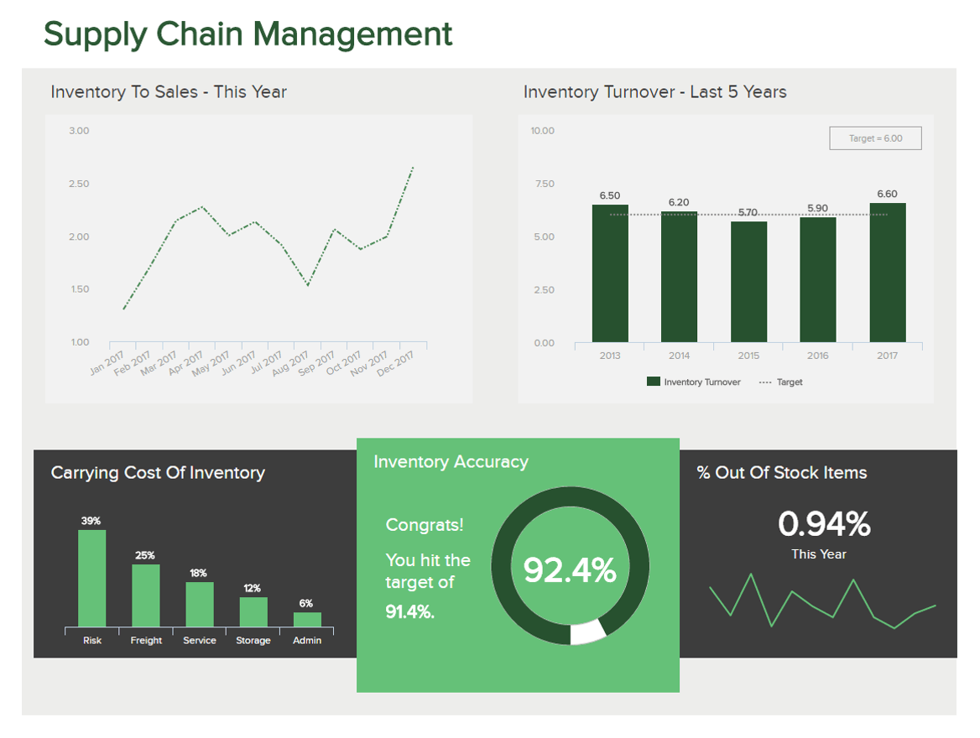
Examples of Tactical Dashboard?.
a) Supply chain management tactical dashboard
This dashboard concentrates on the supply chain of a logistics company.
It shows metrics such as the inventory-to-sales ratio and the inventory turnover show the financial stability of a company – you need to know the ratio between your sold items and items in stock.

Slide 25
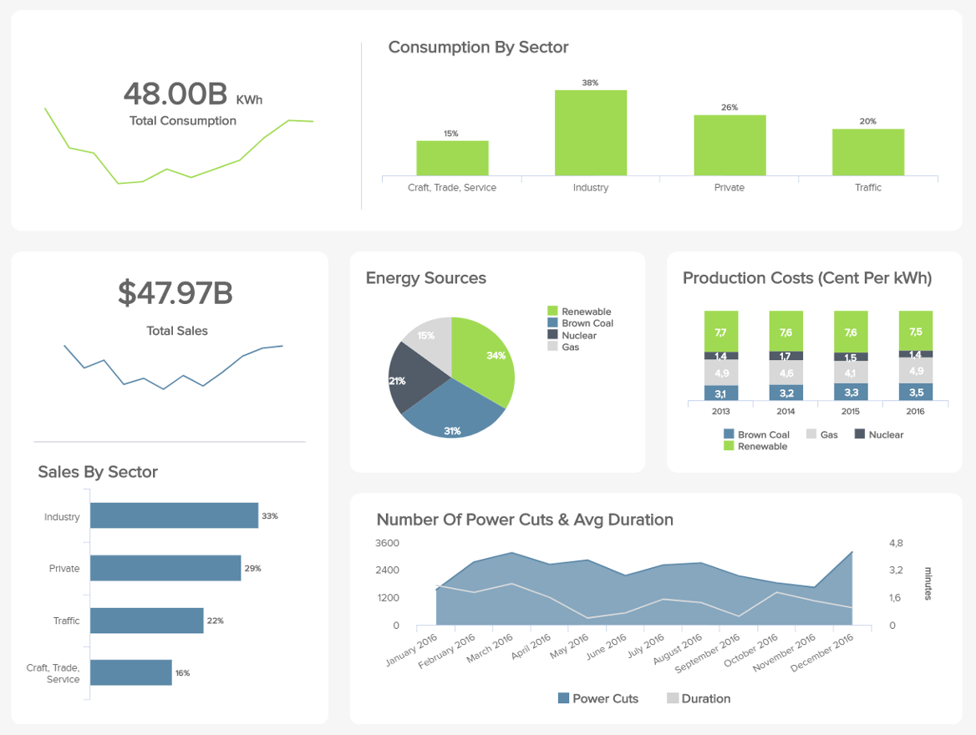
Examples of Tactical Dashboard?.
b) Energy Management dashboard
A power plant provides energy to several sectors and industries, this leads to massive amounts of data being produced every day with hidden trends and improvement opportunities waiting to be untapped.
The provides us with an overview of every relevant aspect for a correct management of an energy business: from the total sales to the consumption by sector, to the production costs per source type, you get the big picture of the different plants’ performance.

Slide 26
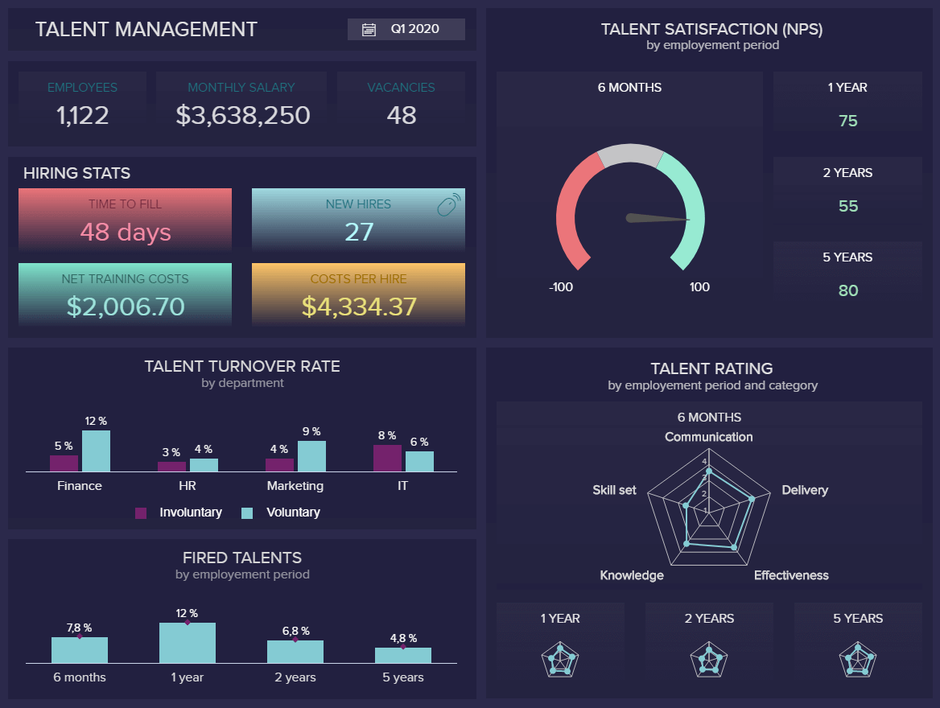
Examples of Tactical Dashboard?.
c) Human Resources Talent Management
For a long time now, one of the biggest challenges for HR departments no matter the business size has been to manage talents efficiently, and therefore, keeping them for longer periods.
The dashboard monitors metrics such as costs, hiring stats, turnover, and satisfaction rates, the total number of employees in the company, an average monthly salary, and vacancies for the first quarter of the year.

Slide 27
The Do’s & Don'ts For A Successful
Business Dashboard Implementation
Before you run off to the dashboard printing presses, we mean data visualization software, let’s talk about it
1. Save time across an organization: IT, analysts, managers, C-suite, etc.
2. Save companies money by highlighting unnecessary operational costs
3. Provide insight into customer behavior
4. Effectively align strategy with tactics
5. Ensure a goal-driven and performance-based data culture
6. Encourages interactivity and analysis

Slide 28
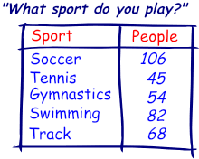
What is Data?
Layman’s Language:
Data can be texts or numbers written on papers, or it can be bytes and bits inside the memory of electronic devices, or it could be facts that are stored inside a person’s mind

Slide 29
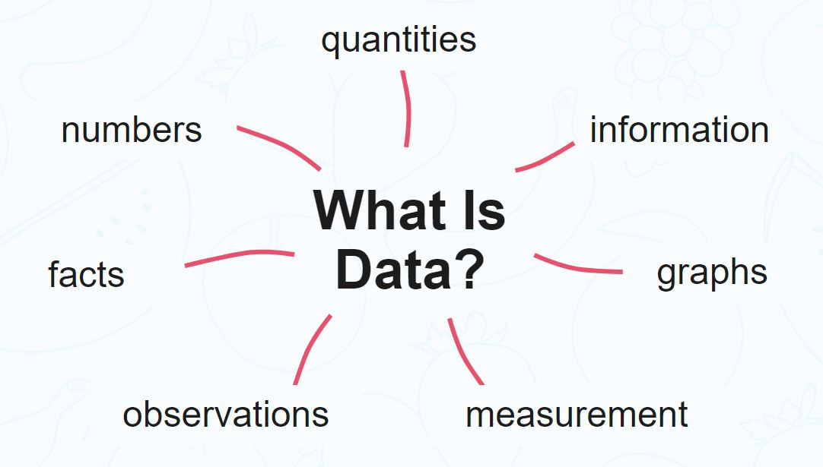
What is Data Analytics?
Scientifically:
Data means information, more specifically facts, figures, measurements and amounts that we gather for analysis or reference.
The term’s meaning also includes descriptive information about things, plants, animals, and people. We collect and store data typically through observation.

Slide 30
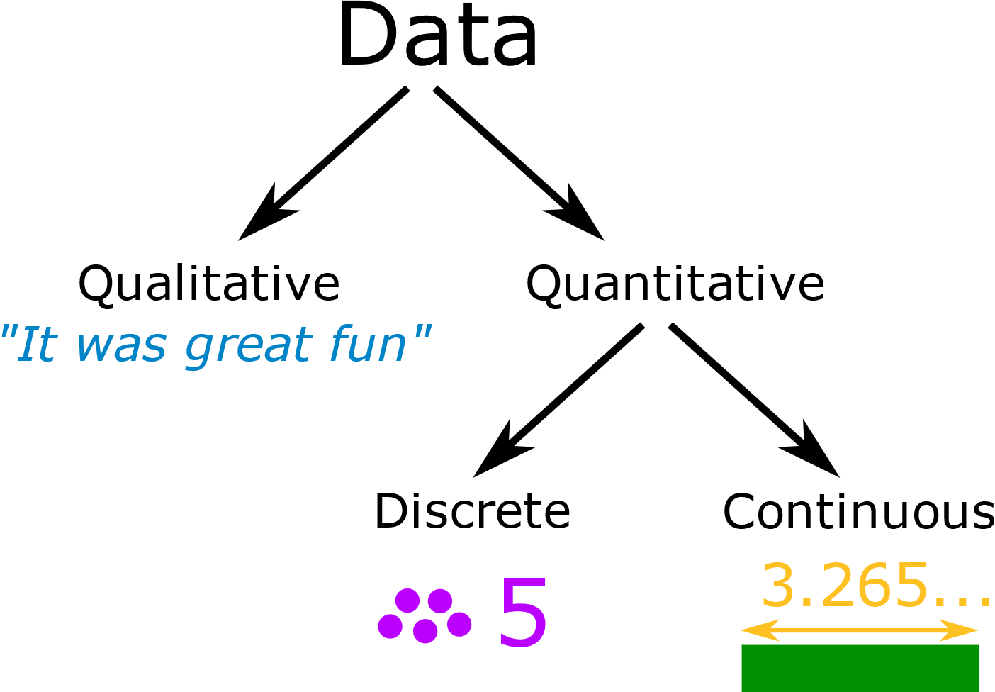
Types of Data
Data can be qualitative or quantitative.
Qualitative data is descriptive information (it describes something)
Quantitative data is numerical information (numbers)

Slide 31
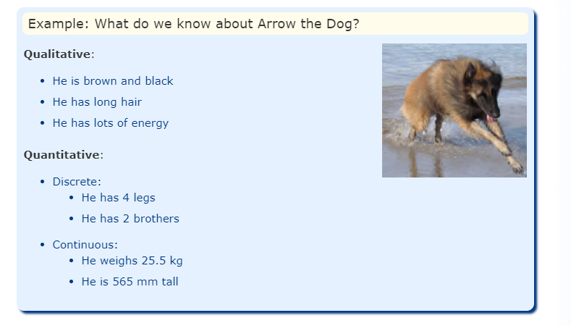
Quantitative data can be Discrete or Continuous:
Discrete data can only take certain values (like whole numbers)
Continuous data can take any value (within a range)
Put simply: Discrete data is counted, Continuous data is measured

Slide 32
Use Cases of Data
Today’s organizations have vast amounts of data from all aspects of their operations.
It is used in:
E-commerce personalization
Recommendation engines
Telecommunications
Financial services
Insurance fraud detection
Healthcare
Education

Slide 33
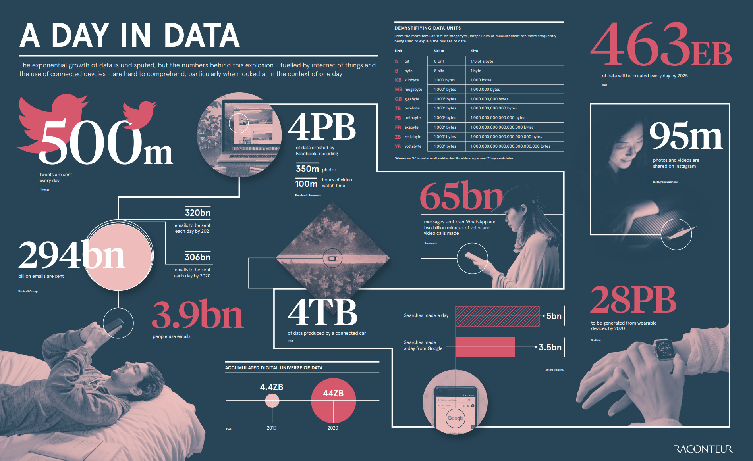
How Much Do We Generate

Slide 34
Here are some key daily statistics highlighted in the infographic:
500 million tweets are sent
294 billion emails are sent
4 petabytes of data are created on Facebook
4 terabytes of data are created from each connected car
65 billion messages are sent on WhatsApp
5 billion searches are made

Slide 35
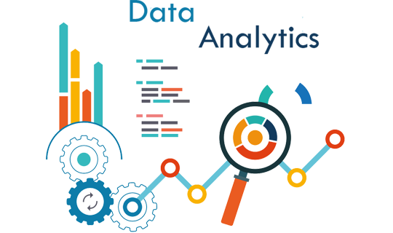
What is Data Analytics?
Data analytics (DA) is the process of examining data sets in order to find trends and draw conclusions about the information they contain. Increasingly data analytics is used with the aid of specialized systems and software.
Data analytics and techniques are
widely used in commercial industries
to enable organizations to make
more-informed business decisions.

Slide 36
Process of Data Analytics
Below are the common steps involved in the data analytics method:
Step 1: Determine the criteria for grouping the data
Data can be divided by a range of different criteria such as age, population, income, or sex. The values of the data can be numerical or categorical data.
Step 2: Collecting the data
Data can be collected through several sources, including online sources, computers, personnel, and sources from the community.
Step 3: Organizing the data
The data must be organized after it is collected so that it can be examined. Data organization can take place on a spreadsheet or other type of software that is capable of taking statistical data.
Step 4: Cleaning the data
The data is first cleaned up to ensure that there is no overlap or mistake. Then, it is reviewed to make sure that it is not incomplete. Cleaning the data helps to fix or eliminate any mistakes before the data goes to a data analyst for analysis.

Slide 37
Data Analytics Types
Descriptive Analytics describes the happenings over time, such as whether the number of views increased or decreased and whether the current month’s sales are better than the last one.
2. Diagnostic Analytics focuses on the reason for the occurrence of any event. It requires hypothesizing and involves a much diverse dataset. It examines data to answer questions, such as “Did the weather impact the selling of beer?” or “Did the new ad strategy affect sales?”
3. Predictive Analytics focuses on the events that are expected to occur in the immediate future. Predictive analytics tries to find answers to questions like, what happened to the sales in the last hot summer season? How many weather forecasts expect this year’s hot summer?
4. Prescriptive Analytics indicates a plan of action. If the chance of a hot summer calculated as the average of the five weather models is above 58%, an evening shift can be added to the brewery, and an additional tank can be rented to maximize the production.

Slide 38
Benefits of Data Analytics
1. Decision making improves
Companies may use the information they obtain from data analytics to guide their decisions, leading to improved results. Data analytics removes a lot of guesswork from preparing marketing plans, deciding what material to make, creating goods, and more
2. Marketing becomes more effective
When businesses understand their customers better, they will be able to sell to them more efficiently. Data analytics also gives businesses invaluable insights into how their marketing campaigns work so that they can fine-tune them for better results.
3. Customer service improves
Data analytics provides businesses with deeper insight into their clients, helping them to customize customer experience to their needs, offer more customization, and create better relationships with them.
4. The efficiency of operations increases
Data analytics will help businesses streamline their operations, save resources, and improve the bottom line. When businesses obtain a better idea of what the audience needs, they spend less time producing advertisements that do not meet the desires of the audience.

Slide 39

What Is Data Visualisation?

Slide 40
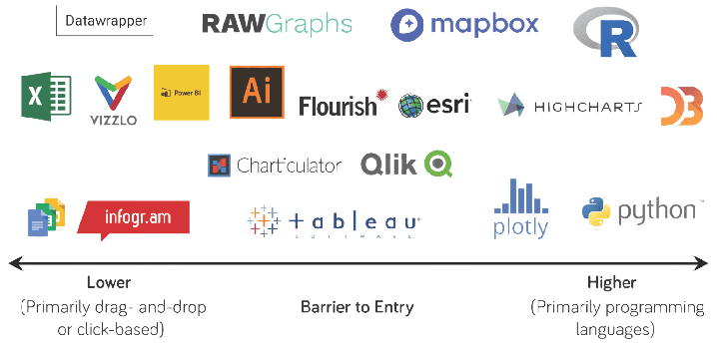
Data Visualization Tools
“They helps people see and understand data easily”

Slide 41
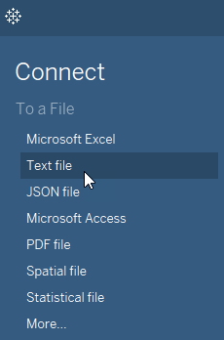
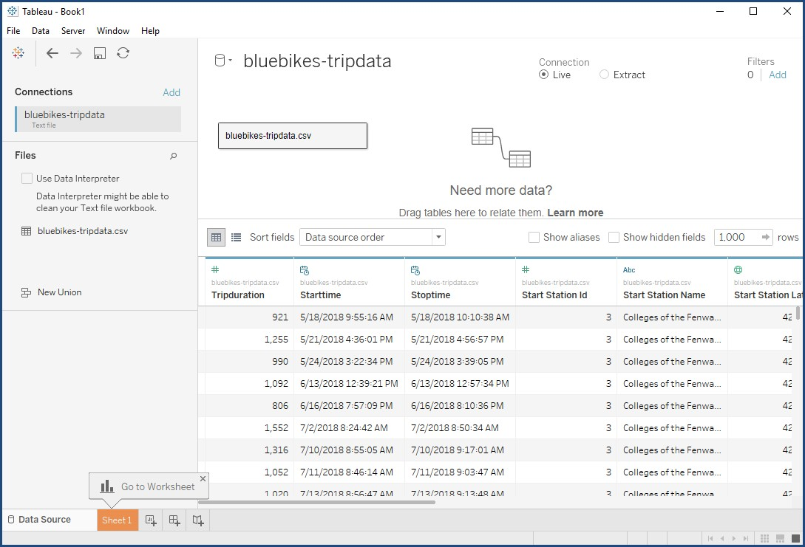
Connecting to the Data

Slide 42
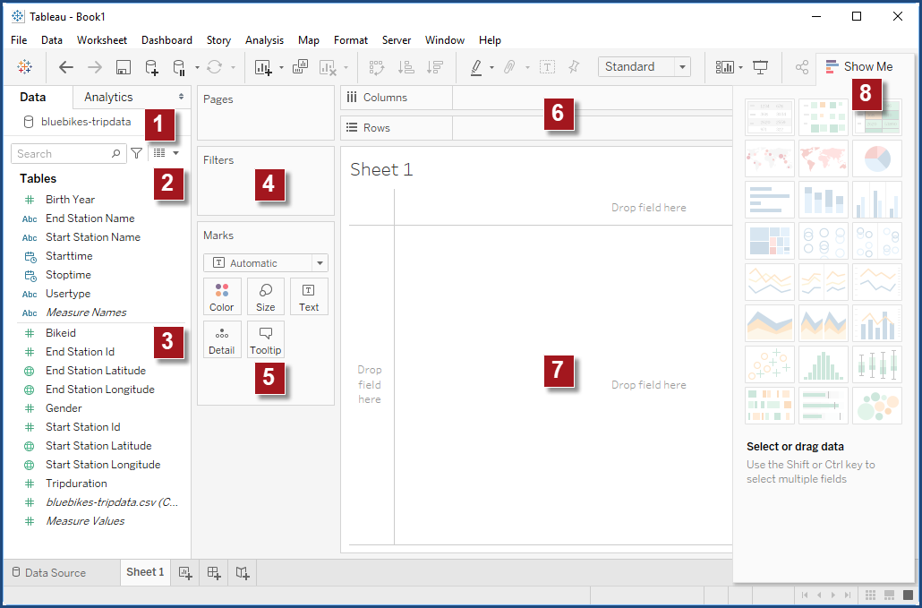
Tableau Interface
Data Source
Data Elements:
2. Dimensions: Categories and labels
Measures: Numbers that you
can work with mathematically
Drag-and-Drop Areas:
4. Filters: Limiting the data
5. Marks Card: Applying color, size, etc.
Columns/Rows: Add vertical
or horizontal labels or axes
Other Areas:
7. Canvas: Where your viz appears
8. Show Me: Viz shortcuts
9. Tabs/New Worksheet

Slide 43
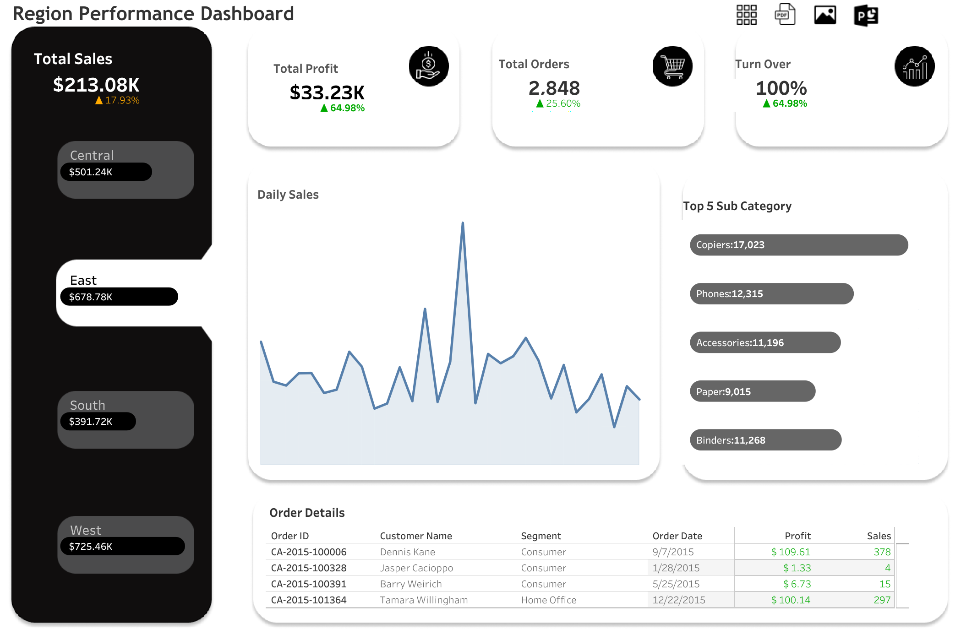
Tableau Dashboard

